Slide 1
Website Development Journal
Abrar Siddiqui – 11DT2

Slide 2
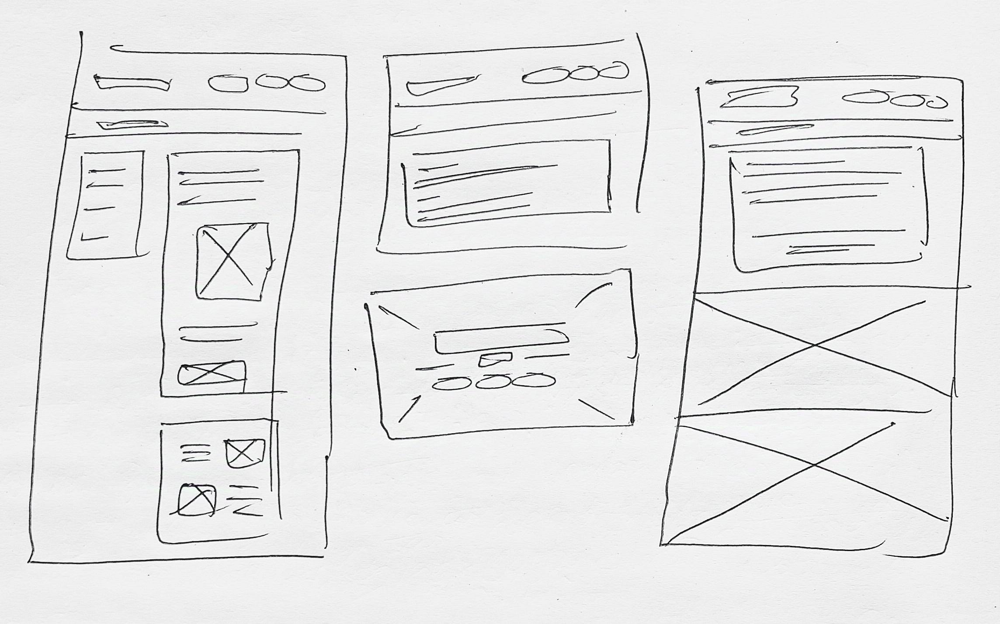
Making Draft Mockup
After figuring out my end-users and the requirement of my website, I first made a hand-drawn mockup. The boxes are elements, and the straight lines mean texts. The crossed boxes mean images.

Slide 3
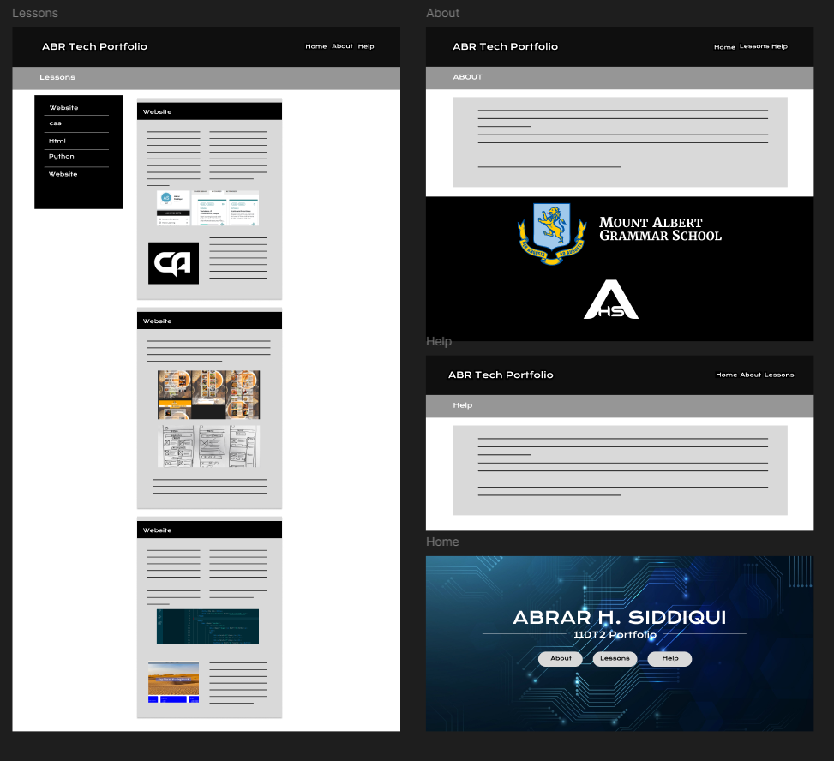
Making High-Fidelity Mockups
After making the hand-drawn mockup, I used that format to make a high-fidelity mockup in Figma. I gathered resources from the internet and my own collection. I used black and white as a theme color as both are contrasting colors and white over / black over white texts will be easier to spot and read.
My website will have 4 pages. One is the Home cover page, the others are ‘About’, ‘Help’ and ‘Lessons’.

Slide 4
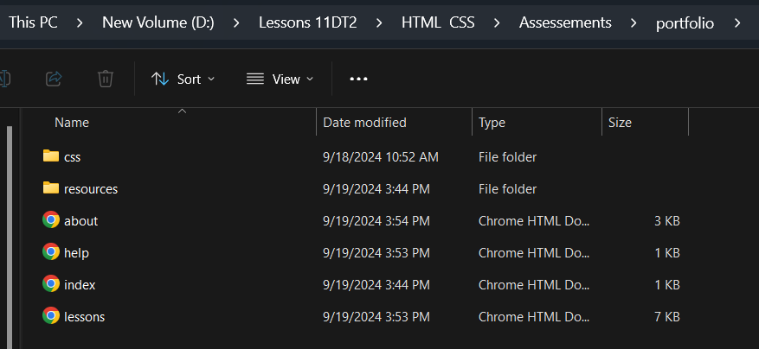
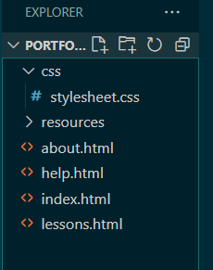
Setting up
After making the finalized mockup, I made a folder named “Portfolio” which contains a “css” and a “resources” folders. I opened the folder in ‘Visual Studio Code’.
After opening “Portfolio”, I made the following html files (the document where I will be coding) and css files (documents in which I will styling my code) :
Index.html (home page)
About.html (about page)
Help.html (help page)
Lessons.html (lessons page)
css ( where I will style my website)

Slide 5
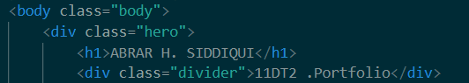
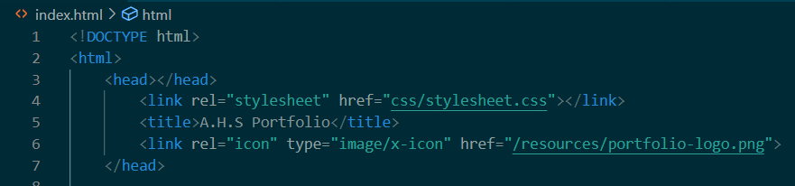
Starting html
I put down <!DOCTYPE html> and make a <html> in which I make a <head> and a <body>.
After that, I link my stylesheet “stylesheet.css” in the head using link rel and href.
I put my title in the <title> and link my web logo using link rel, type and href right under the title.
Then within the body, I make “hero” div in which I make a header which will contain my name. Within the hero div, I made another “divider” div which will contain 11DT2 Portfolio/name of my website. I decided to make it a div so that I can later add dividers next to both of its sides for aesthetic and visibility reasons.

Slide 6
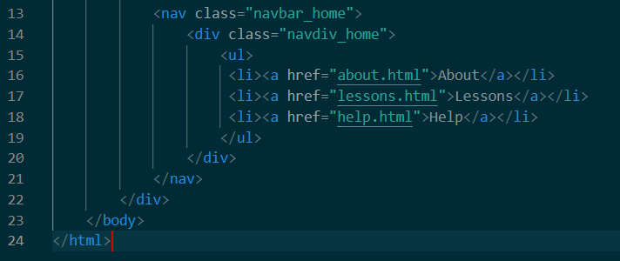
After the name, I started making the navigation bar for the cover home page. I started by making a nav div and classifying it at “navbar_home” which contained another classified as “navdiv_home”. I made an unlisted list which contained links of all the other html pages I made earlier except index.html. I made so that each respective page won’t have the link to that same page so that my end-users don’t keep pressing the home button while already being in the home page. I linked the other html files using <li>, <a> and href. I wrote the names of those pages within the <a>.
After linking, I finished both of the divs along the “hero” div.. After that also finished the body of the cover home page. After </html> “index.html was done.

Slide 7
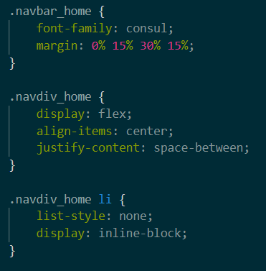
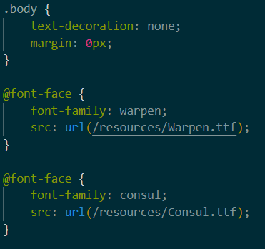
Starting css
After the header, I moved on to my css file and started it. Firstly, I put 0px margin so that in the .body as well as no text decoration.
Then I started the styling the navbar. I put my Consul as the font family and used margin to align the navigation bar according to my design.
After that, I added all the necessary fonts I will be using which aren’t available in the software directly using @font-face and src: url.
For my website, I will use Warpen, Consul and Calibri
Then I used flex, aligned them center and used justify content to equally spread them within the div area horizontally.
Lastly, I put display: inline-block for “navdiv_home” as it will keep the buttons inline after I make them into blocks

Slide 8
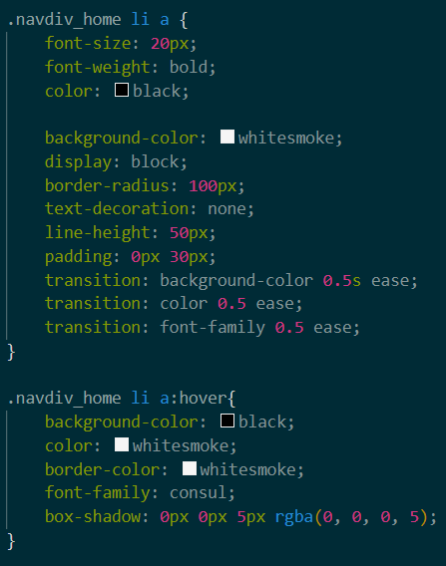
After aligning the links, I started styling the buttons by first putting the font-size, font-weight and font-color in navdiv_home li a
Then I put the background color for those link buttons and used display: block. This way, I can later make the hovering affect. I then adjusted my border-radius, height, padding as well as hover transition time.
Lastly, I put the background color, font color, font size as well as box shadow when hovered in .navdiv_home li a:hover

Slide 9
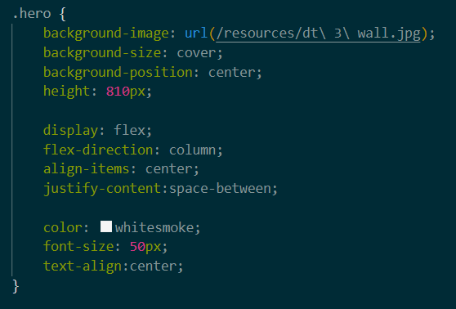
Adding Hero Background
Without this, the entire style will not be completed. First, I added my chosen background image to my resources folder and thus was able to use it in my css using url in the .hero{]. I made it size to cover and its position to center. Because the image was of good quality and large, it didn’t repeat. I then fixed its height to 810px which made it exactly fit in the desktop monitor. I used flex and made its direction to column so that all the elements are in vertical order. I aligned them center and justified its content to space-between.
Finally, I added the color for my writings to white as my background is very dark and fixed the font size and used text-align to center.

Slide 10
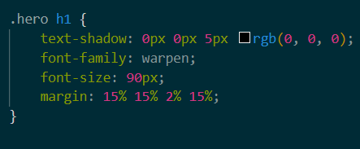
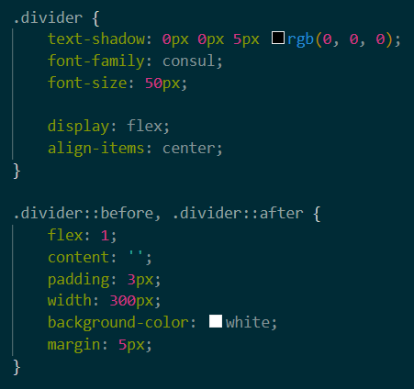
After adding the hero image background, I styled the hero h1 (heading). I fixed the font family to warpen and fixed its font size. I also put a margin to align it according to my mockup. I also added text shadow for visual easiness.
Then, I started on the “divider” class by making it to flex, and center aligned as well as fixing its font family, font size and shadow.
For the actual dividers, I used divider:before, .divider:after to put the dividers and then styled it by fixing its width, color, margin and padding.

Slide 11

Outcome of Cover Home Page

Slide 12
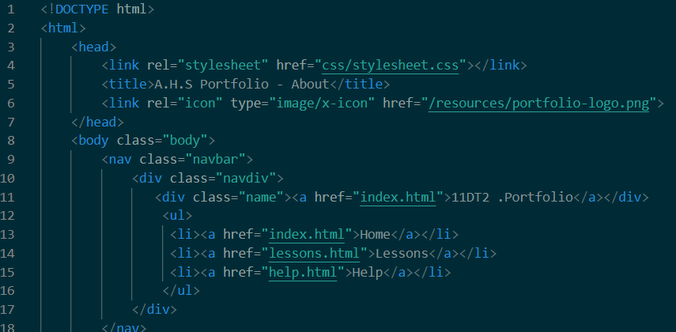
Starting the other pages
After the home page, its now time to start making the navigation bar for the other pages as well. All html files start the same way. The structure for navigation bar is also very similar except the part there is another div classified as “name” which contains the name along with a <a> linking it to the index.html.

Slide 13
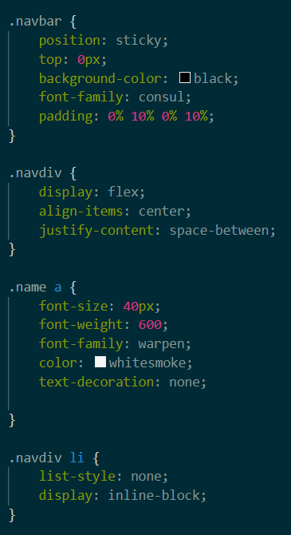
Now for the css, all of it is very similar as well. Except the part because there is another div under navdiv making them horizontally aligned. The margins are slightly changed, and color is set to black.
Then I fixed the font size, font family and its boldness as well as color. I also put no text decoration for the “name”.
I also put position to sticky and put top to 0px. This way the navigation bar won’t go away when I scroll down.

Slide 14
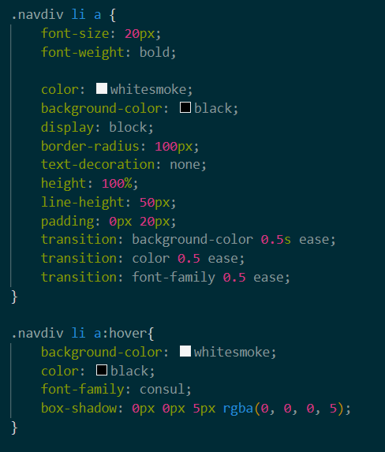
After that, the navdiv, li and a, all have the same transitions and characteristics for hover. But here the color changes from black to white instead of white to black. All the classified divs have same name except that they have ‘_home’ but the other pages don’t. Then I copy-pasted this to all the html except the home .

Slide 15
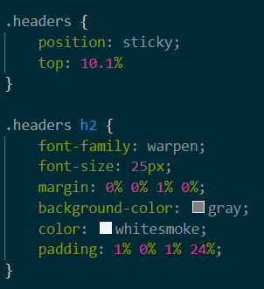
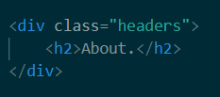
Starting about.html
After the navigation bar, in about.html, I made another div and classified it as “headers” and typed “About” in a h2.
After that I went to css and made the header sticky and put top so that remains just under the navigation bar when scrolled down.
In .header h2, I fixed its font family, size and put margin under it so that other divs don’t touch it. I fixed its background to grey and color to white and added a little padding so that the h2 is aligned with other divs and not toucing the side of the website.

Slide 16
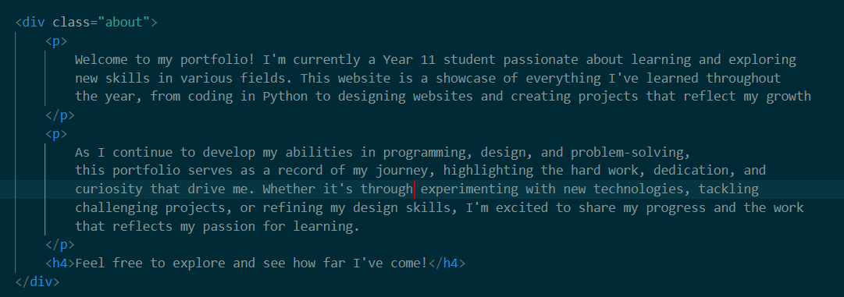
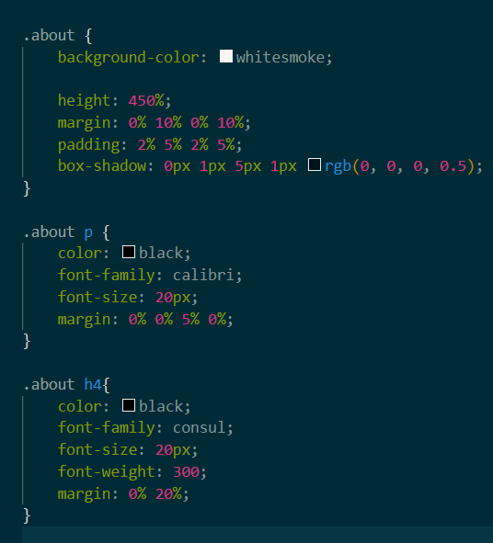
After header, I made another div called “about”. I then added two <p> in which I typed my introduction and description of the website.
After the p’s, I put a h4 which contained mt call to action/invitation to all my end-users.
In css, in .about{}, I then put the background color, fix its height and size of the div using margin and padding. I also use box shadow to give it depth.
I then in .about p, I fix its color to black and font family to Calibri. I put a margin to it so that it doesn’t touch the box’s sides.
As for the h4, I did the same things but changed the font-family to consul and the margin was to both the side moving it to the middle of the div box.

Slide 17
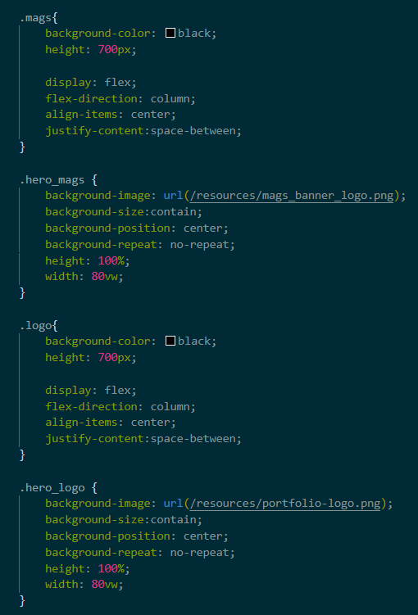
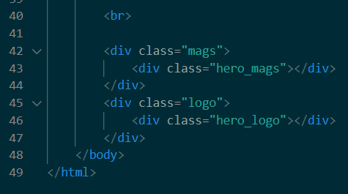
After the “about” div in about.html, I put a <br> and then two divs, “mags” and “logo” respectively which contained another div, “hero_mags” and “hero_logo” repectivly. Then I finished the body and html respectively.
In css, since both the pictures are png, I gave a background color for the mags and logo divs . I used flex and center align with justify space between to make the png always stay in the middle of the div.
I fixed the divs height to 700px. Then I added the background image by linking its url from my resources folder. I put the background size to contain and its position to center. I put no repeat after that made its height to 100% along 80vw so that its doesn’t touch the sides of the website.
I copy pasted all of it and just changed the class names to ‘logo” and “hero_logo” and changed the url to the website logo.

Slide 18
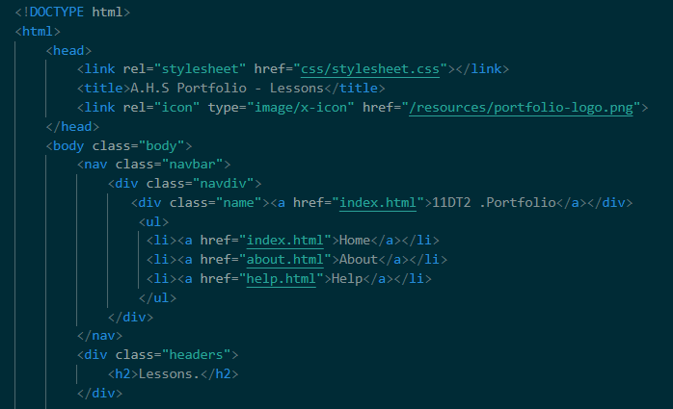
Starting lessons page
The lessons page also starts similarly and so I copy pasted the html code from about.html (upto the “headers”) to lessons.html. This way the navigation bar and the header is already done. The properties of the stylesheet are shared to all html as they are all linked to the same stylesheet and use the same class.
After pasting, I just changed the headers h2 to Lessons instead of About.

Slide 19
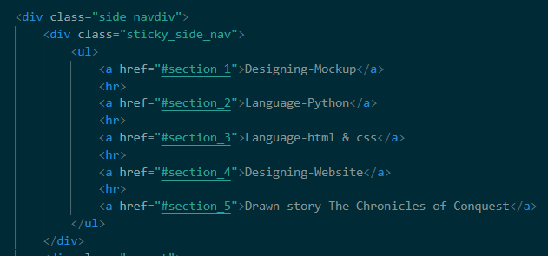
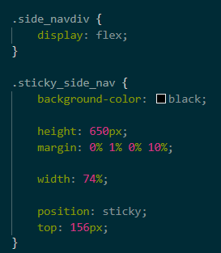
After the header, I made a div named side_navdiv . This way I can make a side navigation bar. After that I made another div named “sticky_side_nav” . In it, I made and un-numbered list which contained <a> that linked to different id sections. This anchors contains the names of the units there are in this page. I put a <hr> between every <a> so that those can help differentiate between the options easily.
I’ll later appoint an id to every header in present within the div.
In css, put flex in side_navdiv and adjusted the size of sticky_side_nav using height, margin and width. I put black background color and made it into sticky with top of 156px that makes it align just under the header h2 when scrolled up.

Slide 20
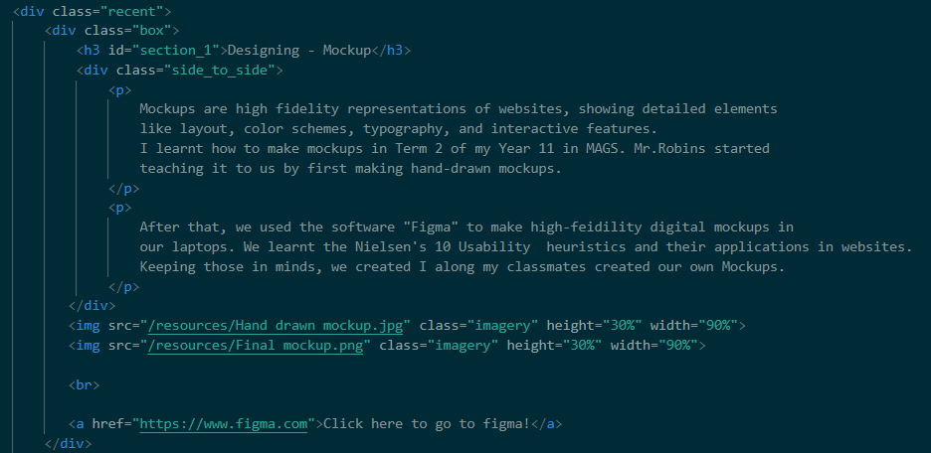
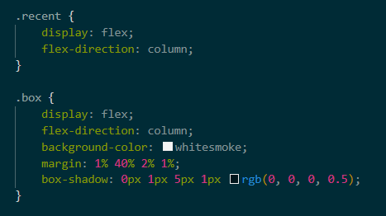
After the side navigation div, I made another “recent” div which contains “box” divs. I put column flex in it allowing me to have different box divs in a vertical alignment . Each box divs contains <p>. The <p>s are in another div “side_to_side” so more aesthetics as this will allow me to use flex in and thus, they will be columns side by side.
I also gave the h3 an id=“section_1” which allows it to link to the side navigation div.
In css, both .recent and .box have flex-column. Then I put margin to the box so that they are spaced between the div and other boxes. I also added box shadow for depth.

Slide 21
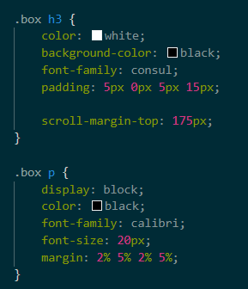
Then In css, I added color, background color and font family to box h3 and box p. I also added padding tp h3 and margin to p so that they are spaced around and match up with the mockup design.
I added scroll margin top to 175px to .box h3 so that when the side navigation is used, the heading of that section comes at the top instead of scrolling to the middle of the “box” div.

Slide 22
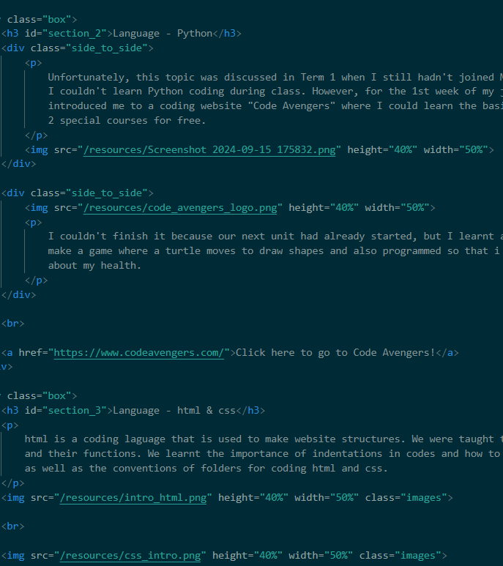
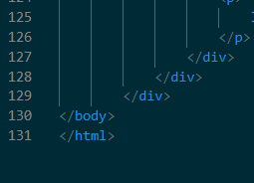
After that, I returned to lessons.html and copy pasted the “box” div and assigned id to them in numerical order like “section_2” , “section_3” and so on. I added <p> (for text)and <img> (for images) and <a> long href (for links) as necessary.
I fixed the height and width of the images within the <img> tag.
I have like 5 sections and after those, I finished my body and html respectively.

Slide 23
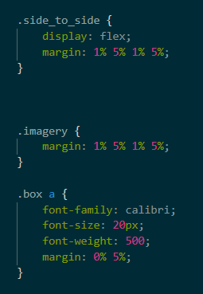
In html earlier, I made ‘side-to-side” div . In css, by making it flex, the two divs are aligned horizontally. I added margin to them so that there is space between.
For some images, I added “imagery” class. In css, I added a margin for them so that the images don’t touch the sides.
Earlier I added some links inside my box divs using <a> . For styling the text there, I added .box a and gave it a fixed font family, size, weight and also a bit of margin so that theres space between the last element and the bottom of the div.

Slide 24
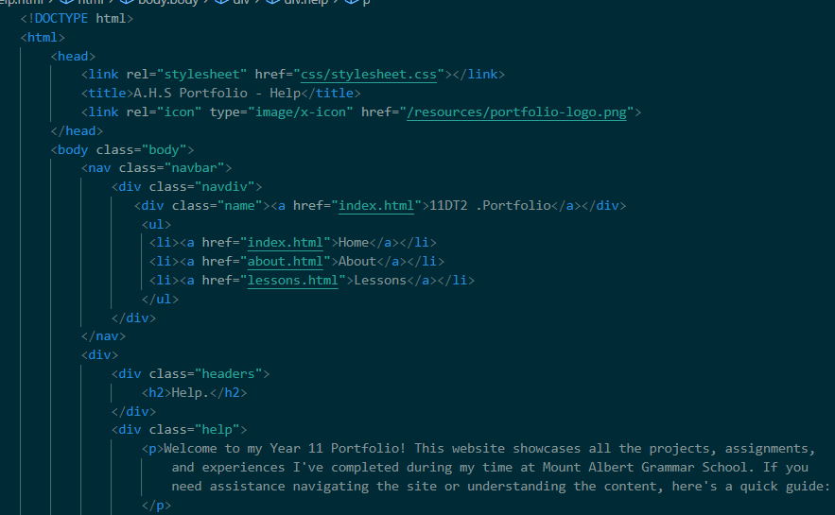
Starting help.html
The starting, navigation portion along the headers div was earlier copy pasted from about.html.
After changing the header h2 from About to Help, I added a another div and classified it as “help”. I then added <p> for the description of what to find in “Help”

Slide 25
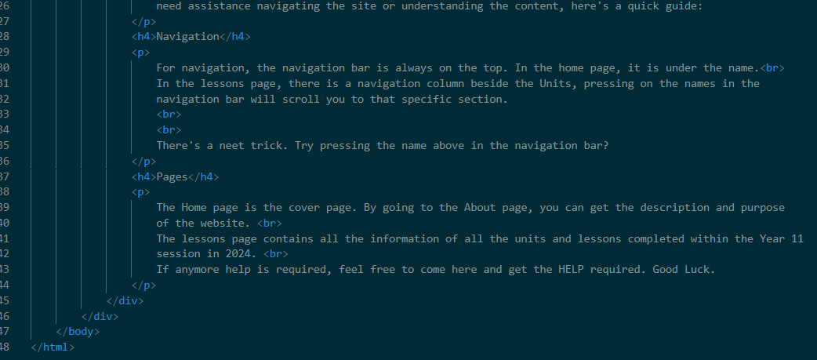
I then added a h4 that says Navigation and used p for typing all the possible ways to navigate through the website.
I then added another h4 saying Pages that included the description and things to be found in each page using a <p> tag.
I used <br> for creating paragraphs within the p tag.
Finally, I finished the ‘help” div, the body and the html too.

Slide 26
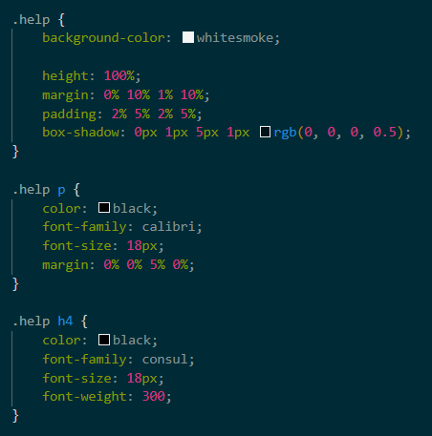
Then I went to my css file and created .help {}, in it, I copy pasted the properties from .about {} as they are similar. I changed the height % as it had less content than about.
Then I created .help p {} and copy pasted about p’s properties.
Next came the header, .help h4 {}, and I copy pasted the properties of .about h4. But I did remove its margin.

Slide 27
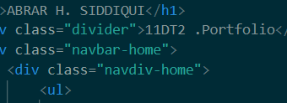
Editing
I previously used ‘ _ ‘ instead of spaces. But later I had realized that the conventions support negative‘ – ‘ and not dashes‘ _ ‘. So, after finishing, I used Ctrl + F to find all the dashes and replaced them with minuses.

Slide 28

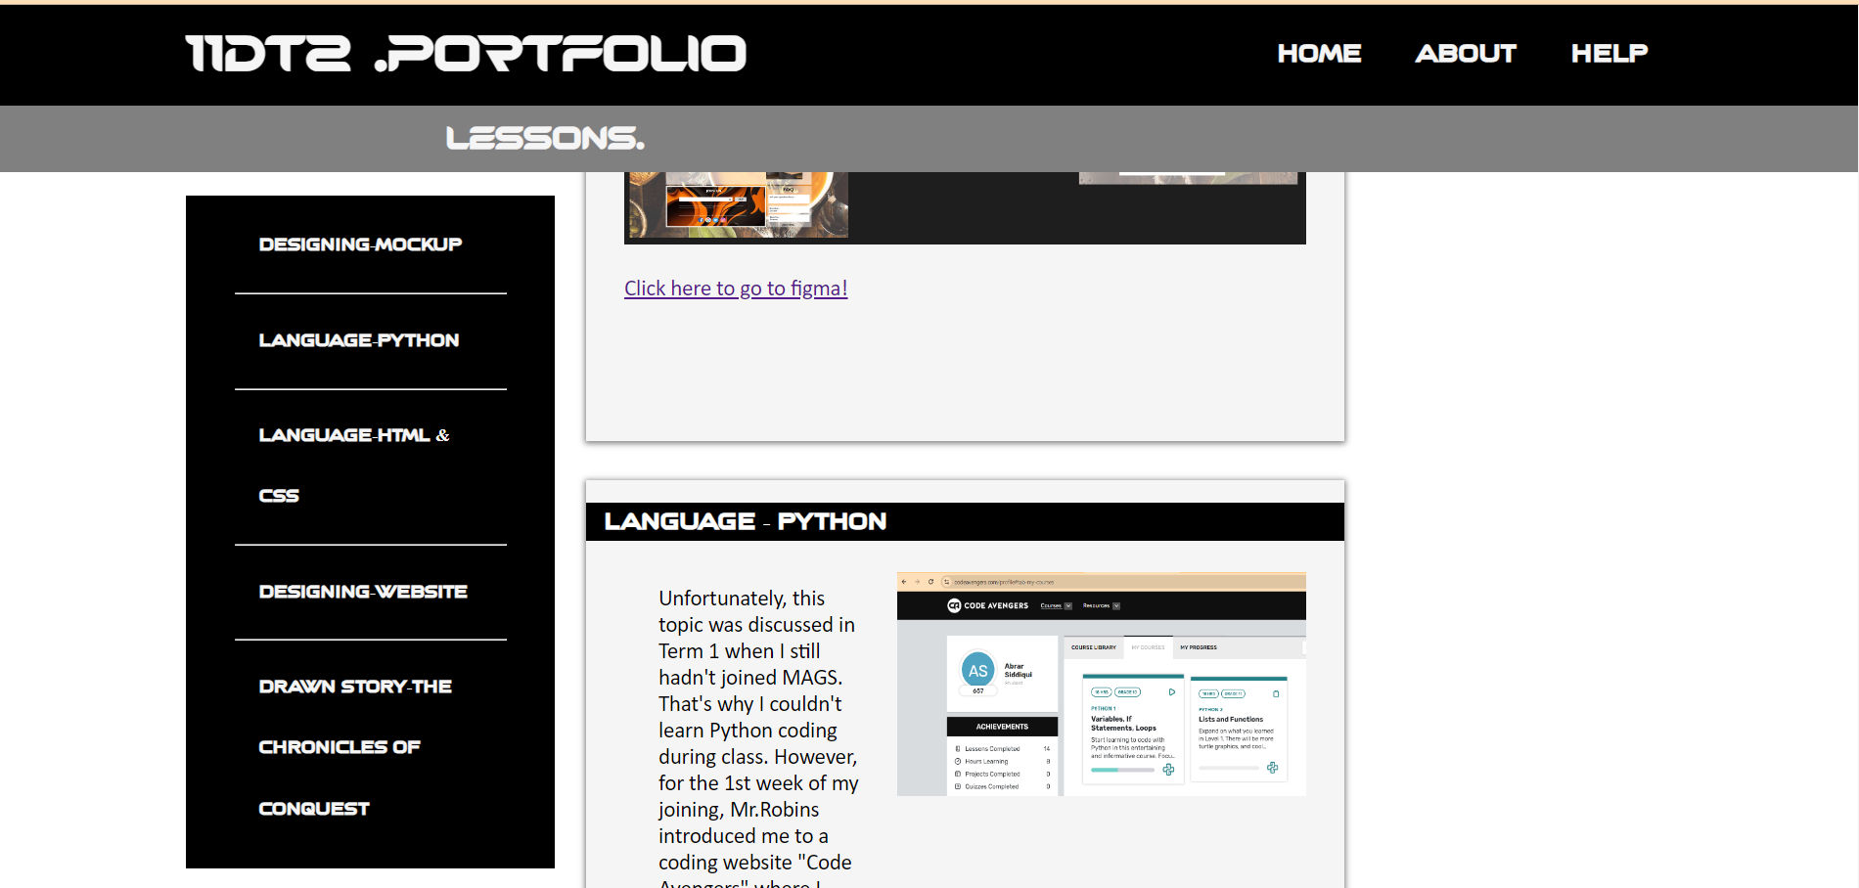
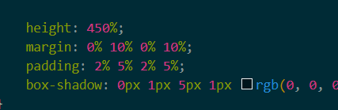
Testing
Every time I did some coding, I used “Go Live” to go to chrome and open my html document there and see my website whether it was according to what I was planning to do. I checked whether my navigation bar was working or not, whether my hover effects were working or not, checking whether my website can adjust its elements to different screen sizes. After determining that, I changed my padding and margins, heights and widths to % from pixels. I made sure my scrolling was smooth, and the navigation bar and the headers were sticky.

Slide 29
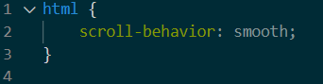
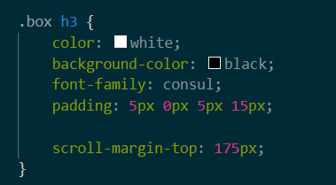
Tracking
Tracking : After developing the website, I requested people who were not affiliated with me in making the website so navigate through it and provide response.
I was asked whether the shortcut scroll using the side navigation tab in the lessons page could be made more like scrolling instead of like changing webpages.
So according to his advice, I put smooth scroll for .html in my stylesheet and include scroll-margin-top of 175px to .box h3. This way, when I press an unit name on my side navigation tab, it scrolls down / up to that specific section instead of teleporting there. This has created a smooth flow to the website increasing my end-user friendliness.

Slide 30

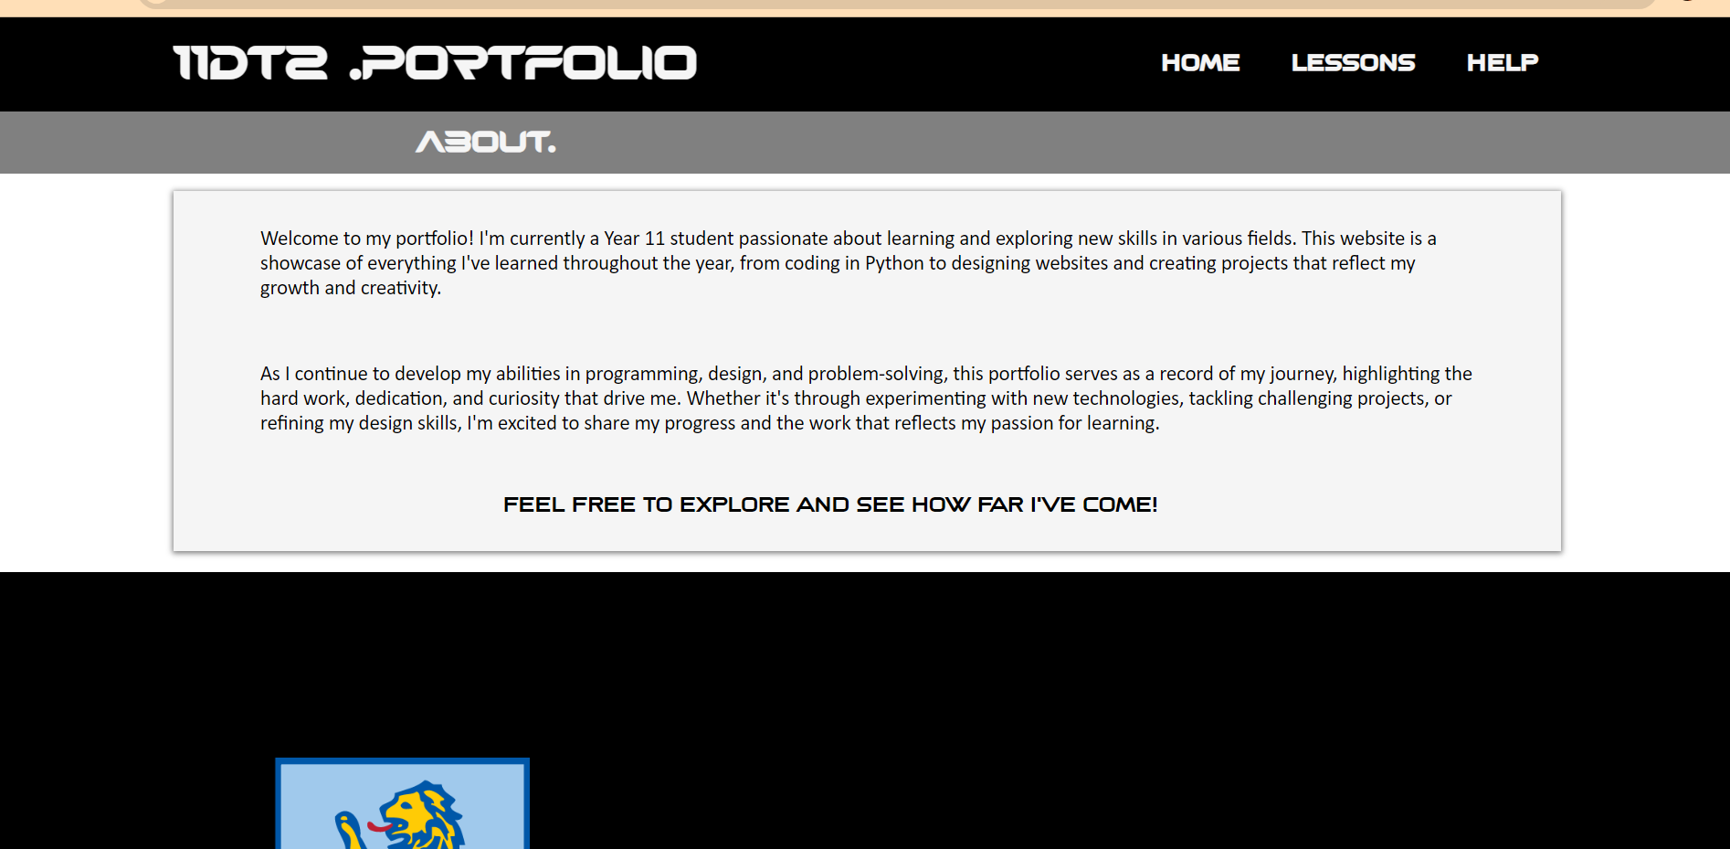
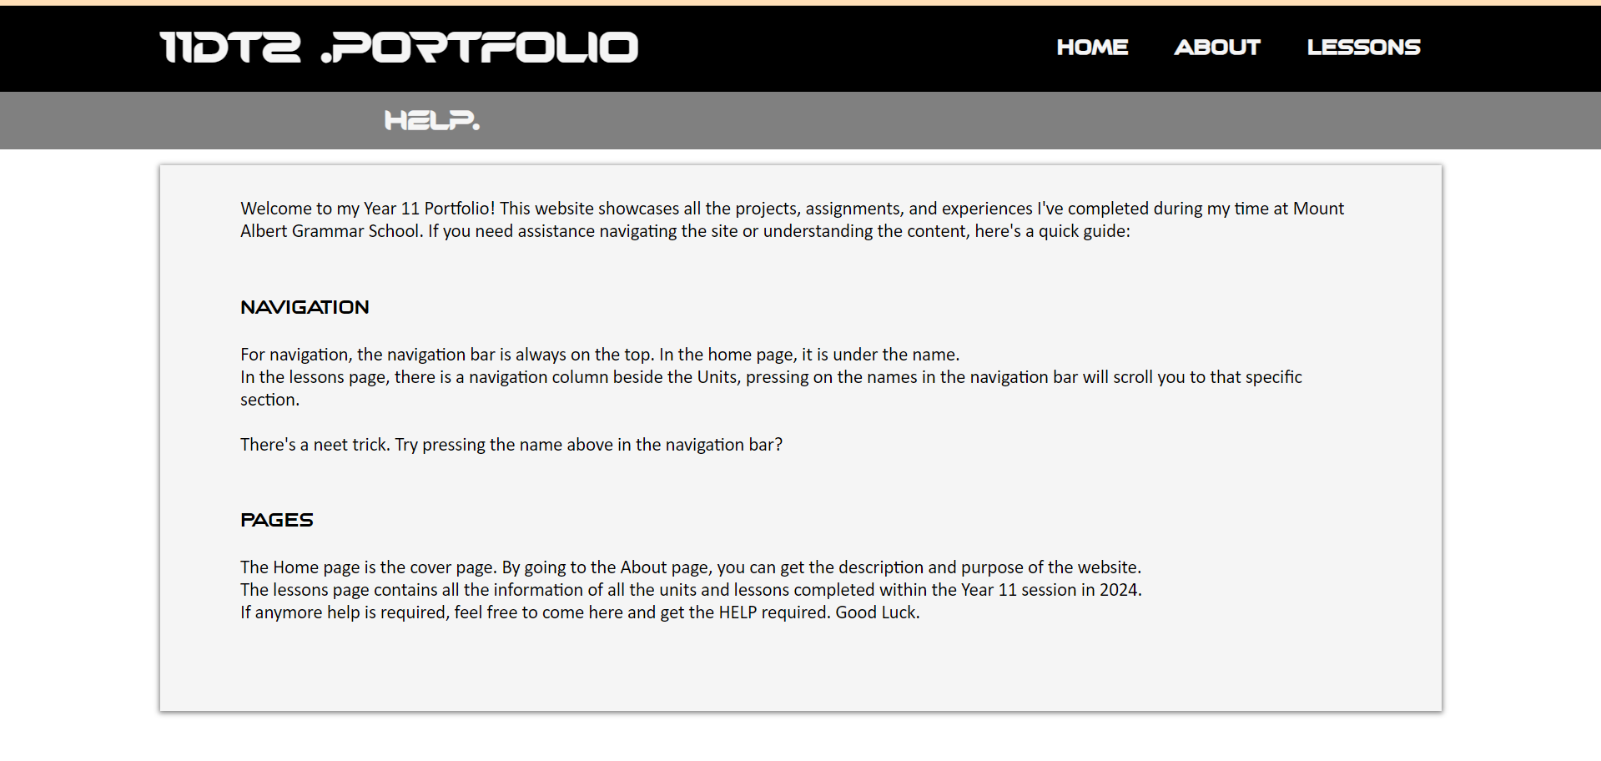
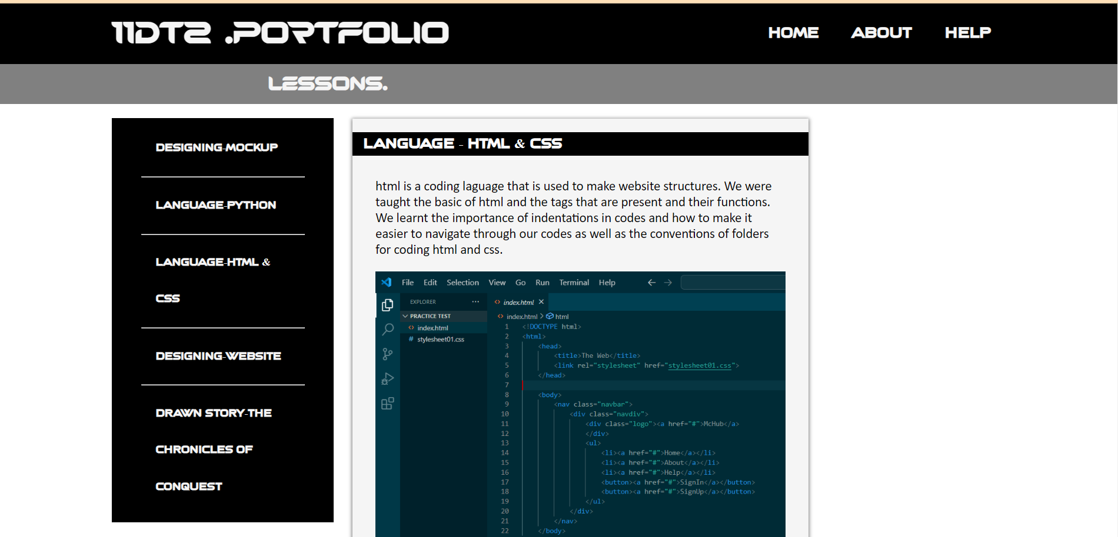
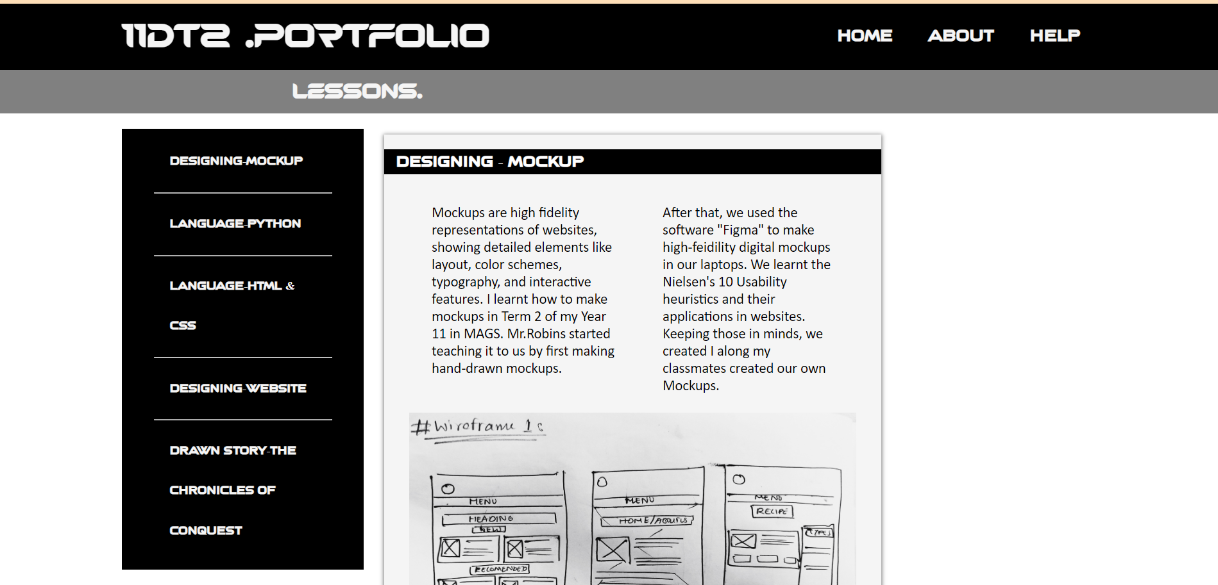
Outcome
After finishing the code. This is the outcome and how my own portfolio website looks like.

Slide 31
END

